Slide 1







Lecture 14:
CRUD Operations using MVC
Course - Web Development - III
-By
Pratik Raj Verma
welcome@krmangalam.edu.in
Sohna Road,Gurugram,Haryana 122103

Slide 2

| Table of Contents
CRUD Operation using MVC
Exporting Controllers
References.
The End.

Slide 3

| CRUD Operations
CRUD stands for:
C → Create
R → Read
U → Update
D → Delete
Real-World Analogy
Imagine a notebook containing student records.
Create
—Write a new student's details in the notebook.
Read
—Open the notebook and view student details.
Update
—Correct or change a student's information.
Delete
—Erase a student's details from the notebook.

Slide 4
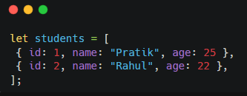
| CREATE Operation
Student Data
This array will be used for all CRUD operations.
Currently, we are not using a real database.
So, we will use an array as a temporary database to understand CRUD operations.
Later, when we learn MongoDB we will store it in the MongoDB database.
Array → Temporary Storage
MongoDB → Permanent Storage

Slide 5
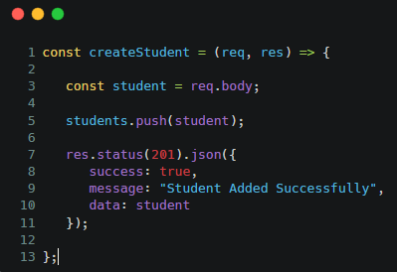
| CREATE Operation
Purpose
Create operation is used to add new data into the application.
Example:
Add a new student.
Logic
Receive data using req.body
Add student using push()
Send success response

Slide 6
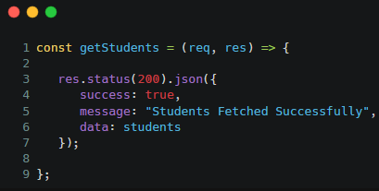
| Read Operation
Purpose
Read operation is used to retrieve data from the application.
Example:
Get all students.
Logic
Fetch all students
Return complete array
Send response to frontend

Slide 7
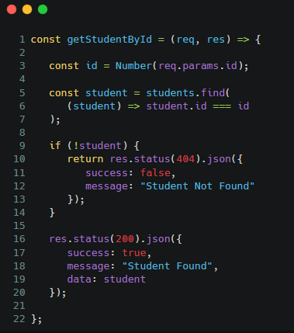
| Read Operation
Purpose
READ Single Student by Index or id
Get single students.
Route for Single Student
app.get("/students/:id", getStudentById)
Logic
req.params
find()

Slide 8
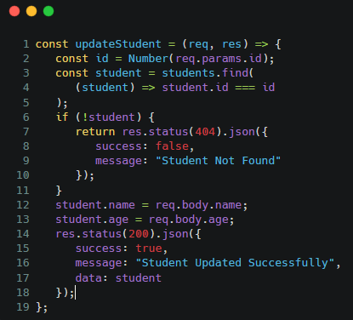
| UPDATE Operation
Purpose
Update Single Student by Index or id
Logic
Find student
req.params
req.body
find()
if condition
Update values
Return updated student

Slide 9
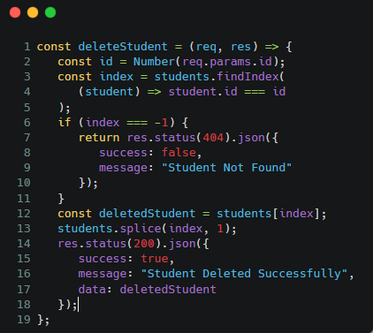
| DELETE Operation
Purpose
Delete operation removes data from the application.
Delete student by ID.
Logic
Find position using findIndex()
Delete using splice()
Return deleted student

Slide 10
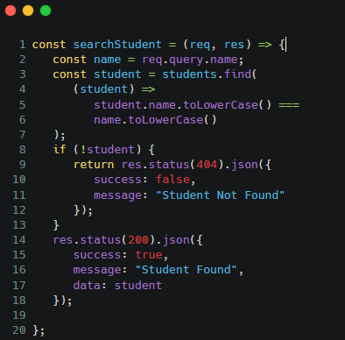
| SEARCH Operation
Purpose
Search Student by name
/search?name=rahul
Logic
Take name by query name
Find student by this name using find()
Return resulted student

Slide 11
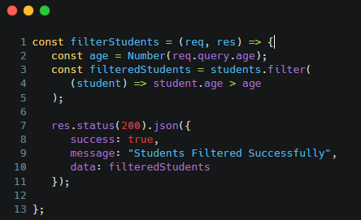
| FILTER Operation
Purpose
filter Students by condition
/filter?age=25
Logic
Returns all students whose age is greater than 21.

Slide 12
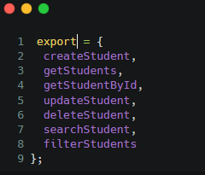
| Exporting Controllers
After creating controller functions, we need to export them so they can be used in other files, such as the routes file
Exporting controllers makes controller functions available to other files, allowing routes to use them while keeping the project organized and following the MVC architecture

Slide 13

| Check Your Understanding
Question : Which operation is used to add a new student into the application?
Options : A. Read
B. Update
C. Delete
D. Create
Answer : D. Create
Explanation:
The Create operation is used to insert new data into the application.

Slide 14
| Check Your Understanding
Question : What will happen if the requested student ID does not exist during the Update
operation?
Options : A. Student will be created automatically
B. Server will crash
C. "Student Not Found" response will be returned
D. Student will be deleted
Answer : c) "Student Not Found" response will be returned
Explanation:
Before updating, the controller checks whether the student exists.

Slide 15
| Check Your Understanding
Question : Which method is used to remove a student from the array in the Delete
operation?
Options : A. push()
B. find()
C. splice()
D. map()
Answer : C. splice()
Explanation:
splice() removes an element from the array using its index.

Slide 16
| References
MDN Web Docs : Comprehensive and official documentation for Express Js 🔗https://developer.mozilla.org/en-US/docs/Learn_web_development/Extensions/Server-side/Express_Nodejs
W3Schools : Beginner-friendly express tutorials with examples and interactive editors. 🔗https://www.w3schools.com/nodejs/nodejs_express.asp
Express Official- A comprehensive tutorial-style website that covers core Express JS concepts in depth.
🔗https://expressjs.com/en/

Slide 17
Thanks
For
Watching
Course - Web Development - III
welcome@krmangalam.edu.in
Sohna Road,Gurugram,Haryana 122103

